Slide 1
Pesticide Suggestion and crop Disease classification using Machine Learning
GUIDE:
Mrs.R.Salini
Assistant Prof, Dept of Cse
Panimalar Engineering College.
TEAM MEMBERS:
FARZANA A.J(211417104062)
YAMINI B(211417104308)

Slide 2
Abstract
Crop cultivation plays an essential role in the agricultural field. Presently, the loss of food is mainly due to infected crops, which reflexively reduces the production rate. To identify the plant diseases at an untimely phase is not yet explored.
The main challenge is to reduce the usage of pesticides in the agricultural field and to increase the quality and quantity of the production rate. Proposed system explore the leaf disease prediction at an untimely action. We propose an enhanced Machine Learning to predict the infected area of the leaves. A color based segmentation model is defined to segment the infected region and placing it to its relevant classes.
Experimental analyses were done on samples images in terms of time complexity and the area of infected region. Plant diseases can be detected by image processing technique. Disease detection involves steps like image acquisition, image pre-processing, image segmentation, feature extraction and classification.

Slide 3
Literature Survey
S.NO | TITLE | YEAR | METHODS | Advantages | Disadvantages
1 | Xin Yang, Tingwei Guo,” Machine learning in plant disease research” | 2020 | K-means clustering used to segment the defected area | They create their own data set | The accuracy level is 92.2%
2 | Yang Lu,Shujuan Yi,Nianyin Zeng,Yurong Liu,Yong hang,” Identification of rice diseases using deep convolutional neural networks” | 2018 | we propose a novel rice diseases identification method based on deep convolutional neural networks (CNNs) techniques | The simulation results for the identification of rice diseases show the feasibility and effectiveness | Less Number of dataset will be trained.

Slide 4
S.no: 3 | TITLE P. R. Rothe and R. V. Kshirsagar,” Cotton Leaf Disease Identification using Pattern Recognition Techniques”, | Year 2017 | Method Uses Snake segmentation, Hu’s moments are taken as feature | Advantages Active contour model used to minimize the energy inside the disease spot, BPNN solves the multiple class problems, average classification is found to be 85.52%. | Disadvantages Snake segmentation is a very slow process
4 | Aakanksha Rastogi, Ritika Arora and Shanu Sharma,” Leaf Disease Detection and Grading using Computer Vision Technology &Fuzzy Logic” | 2017 | K-means clustering used to segment the defected area; GLCM is used for the extraction of Texture features, Disease grading using fuzzy logic. | Severity of the disease is checked, Fast and highly efficient | Low-level segmentation.

Slide 5
S.NO 5 | Title S. S. Sannakki and V. S. Rajpurohit,”Classification of Pomegranate Diseases Based on Back Propagation Neural Network,” | Year 2015 | Method K-means clustering used to segment the defected area, color and texture are used as the features | Advantages RGB image is converted to L*a*b to extract chromaticity layers of image, classification is found to be 97.30%. | Disadvantages Only applicable for limited crops.

Slide 6
Existing System
The problem of efficient plant disease protection is closely related to the problems of sustainable agriculture and climate change In India, Farmers have a great diversity of crops.
Various pathogens are present in the environment which severely affects the crops and the soil in which the plant is planted, thereby affecting the production of crops Various disease are observed on the plants and crops .
The main identification of the affected plant or crop are its leaves.
The various colored spots and patterns on the leaf are very useful in detecting the disease.

Slide 7
Proposed system
Our project is to detect the plant diseases and provide the solutions to recover from the leaf diseases.
In our proposed system we are providing a solution to recover from the leaf diseases and also show the affected part of the leaf by image processing technique.
The existing system can only identify the type of diseases which affects the leaf. Its not efficient. We will provide a result within fraction of seconds and guided you throughout the project. We briefly explain about the experimental analysis of our methodology. Samples of 1000 images are collected that comprised of different plant diseases like Alternaria Alternata, Anthracnose, Bacterial Blight, Cercospora leaf spot and Healthy Leaves. Different number of images is collected for each disease

Slide 8
TECHNOLOGY STACK
HardWare Requirements
Processor - Intel Core i7
RAM - 4 GB
Hard Disk - 500 GB
SoftWare Requirements
Operating System - Windows 7/8/10
Programming Language : Python,MySQL

Slide 9
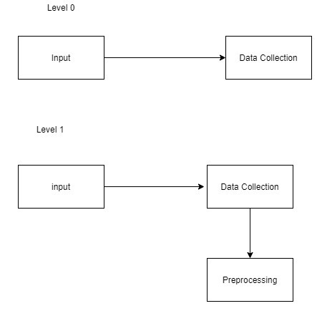
Data Flow Diagram:

Slide 10
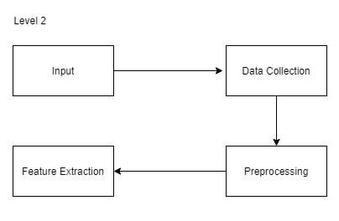
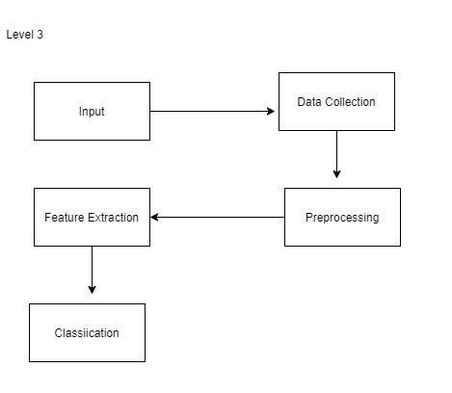

Slide 11
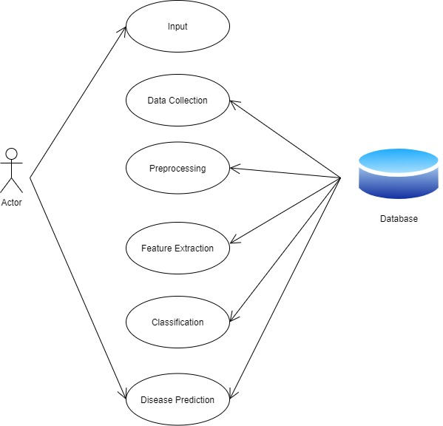
Use case Diagram:
System Design

Slide 12
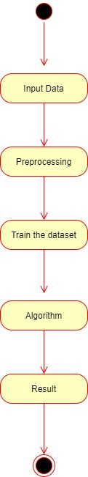
Activity Diagram

Slide 13
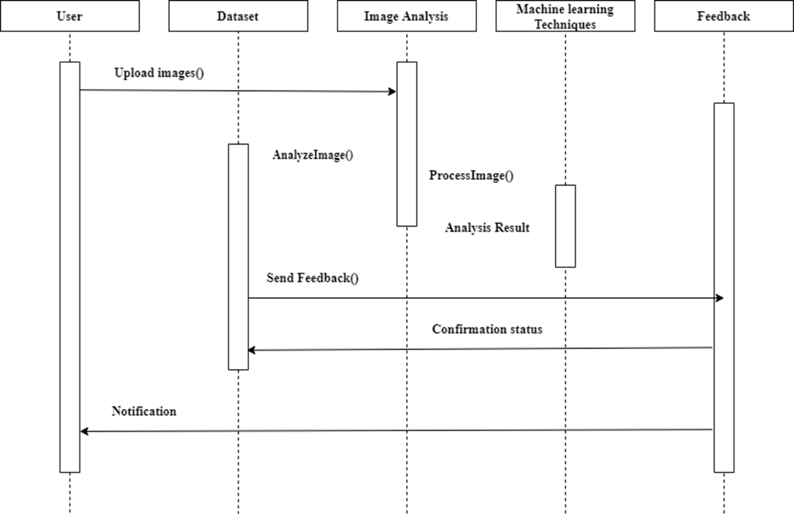
Sequence Diagram

Slide 14
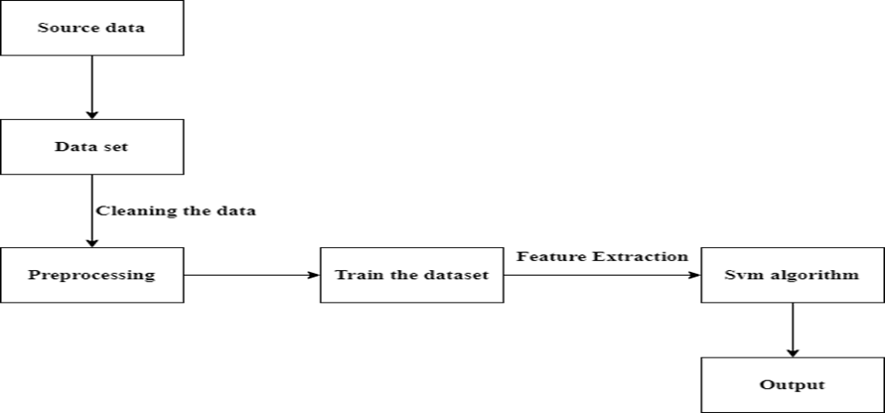
System Architecture
Bacterial leaf blight
Leaf smut
Brown spot

Slide 15
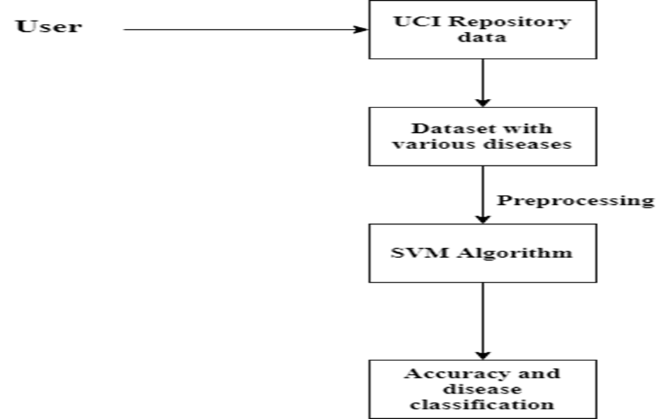
Uml diagram

Slide 16
ADVANTAGES
High Accuracy
Low complexity
Detection of images been classified without any noise

Slide 17
Data Collection
MODULES:
The data collection is done Kaggle.
The data collected has been check one by one before taking it as input data.
There are 2 classes named as affected plants and normal plants will be classified and each of the class contains images.
From the 80% of images used for training and 20% of images used for validation and testing.

Slide 18
Data Augmentation
1)Data augmentation is a method by which you can virtually increase the number of samples in your dataset using data you already have.
2)For image augmentation, it can be achieved by performing geometric transformations, changes to color, brightness, contrast or by adding some noise. In order to let our model, adapt to a different situation that might occur noisy data such as when raining season.

Slide 19
Plant classification
After training for each model, the final two models were generated. One model was trained directly based on original images, while the other one was created using image data produced by data augmentation.
Model history was used to record the training process. which displays the accuracy on the training set and testing set, it is described that the accuracy for the training set is having differences with 5% by with and without data augmentation. Besides, the performance of the model without data augmentation having lower accuracy on the validation set, while the model with data augmentation has a higher result in the testing set.

Slide 20
ALGORITHM:
Support vector machine:
SVMs are helpful in text and hypertext categorization, as their application can significantly reduce the need for labeled training instances in both the standard inductive and transudative settings.
Classification of images can also be performed using SVMs. Experimental results show that SVMs achieve significantly higher search accuracy than traditional query refinement schemes after just three to four rounds of relevance feedback. This is also true for image segmentation systems, including those using a modified version SVM that uses the privileged approach as suggested by Vapnik.
The SVM algorithm has been widely applied in the biological and other science.

Slide 21
SYSTEM TESTING
Testing is an integral component of the software development process. It entails a comprehensive assessment of a software to ensure it meets your client’s requirements and goals.
Unit Testing
Unit testing is the first stage of software testing levels. During this stage, testers evaluate individual components of the system to see if these components are functioning properly on their own.
Integration Testing
Testers perform integration testing in the next phase of testing. Here, they test individual components of the system and then test them as a collective group. This allows software testers to determine the performance of individual components as a group and identify any problems in the interface between the modules and functions.

Slide 22
FUNCTIONAL TESTING
It is a type of software testing that validates the software system against the functional requirements/specifications. The purpose of Functional tests is to test each function of the software application, by providing appropriate input, verifying the output against the Functional requirements.
Functional testing mainly involves black box testing and it is not concerned about the source code of the application. This testing checks User Interface, APIs, Database, Security, Client/Server communication and other functionality of the Application Under Test. The testing can be done either manually or using automation.

Slide 23
TESTING TECNIQUES
White Box Testing:
This testing is also called as Glass box testing. In this testing, by knowing the specific functions that a product has been design to perform test can be conducted that demonstrate each function is fully operational at the same time searching for errors in each function. It is a test case design method that uses the control structure of the procedural design to derive test cases. Basis path testing is a white box testing.
Flow graph notation
Kilometric complexity
Deriving test cases
Graph matrices Control
BLACK BOX TESTING:
In this testing by knowing the internal operation of a product, test can be conducted to ensure that “all gears mesh”, that is the internal operation performs according to specification and all internal components have been adequately exercised. It fundamentally focuses on the functional requirements of the software.

Slide 24
SOFTWARE TESTING STRATEGIES
INTEGRATION TESTING is defined as a type of testing where software modules are integrated logically and tested as a group. A typical software project consists of multiple software modules, coded by different programmers. The purpose of this level of testing is to expose defects in the interaction between these software modules when they are integrated
PROGRAM TESTING:
Program testing is the process of executing a program with the intent of finding errors. A good test is one that has a high probability of finding an error. Program testing cannot show the absence of errors.

Slide 25
Security Testing :
It is a type of Software Testing that uncovers vulnerabilities of the system and determines that the data and resources of the system are protected from possible intruders. It ensures that the software system and application are free from any threats or risks that can cause a loss
Validation Testing:
We check whether the developed product is right. Validation is also known as dynamic testing. Validation includes testing like functional testing, system testing, integration, and User acceptance testing. It is a process of checking the software during or at the end of the development cycle to decide whether the software follow the specified business requirements. Quality control comes under validation testing.

Slide 26
PERFORMANCE TESTING:

Slide 28
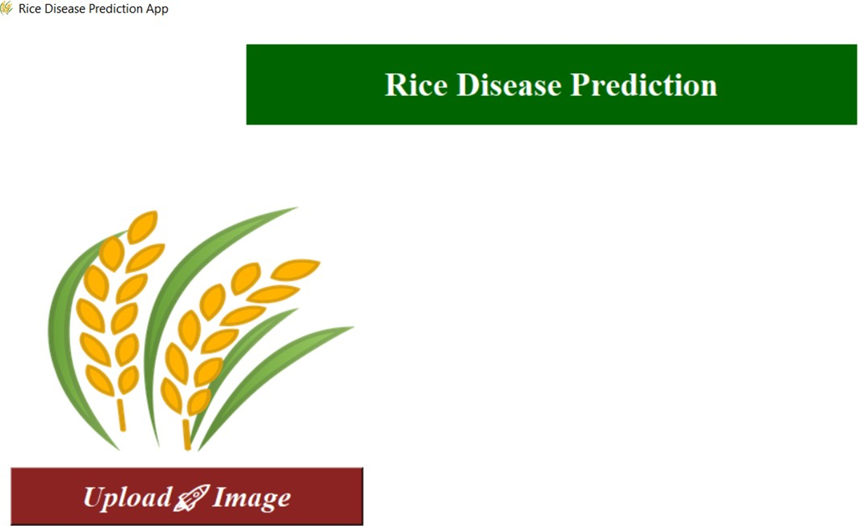
Screenshot:

Slide 29
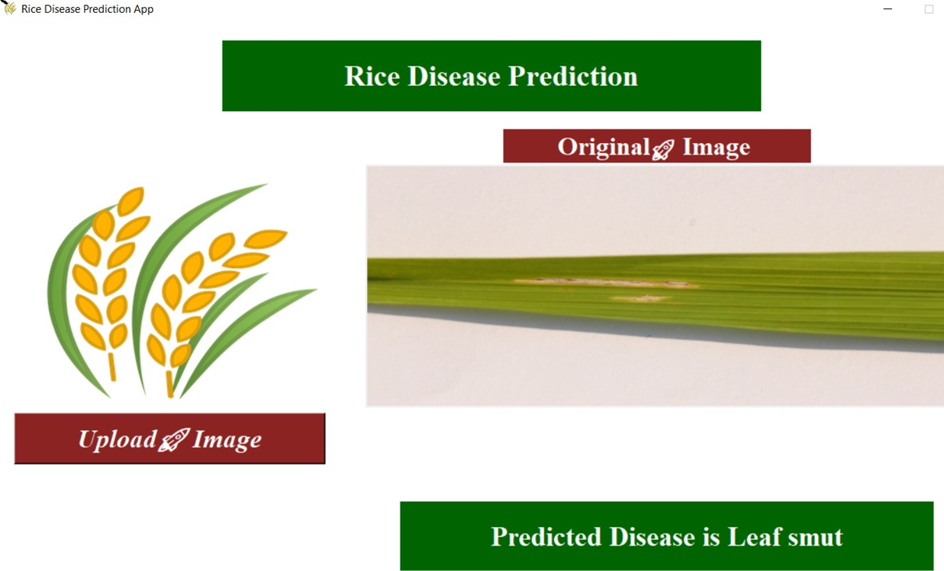

Slide 30
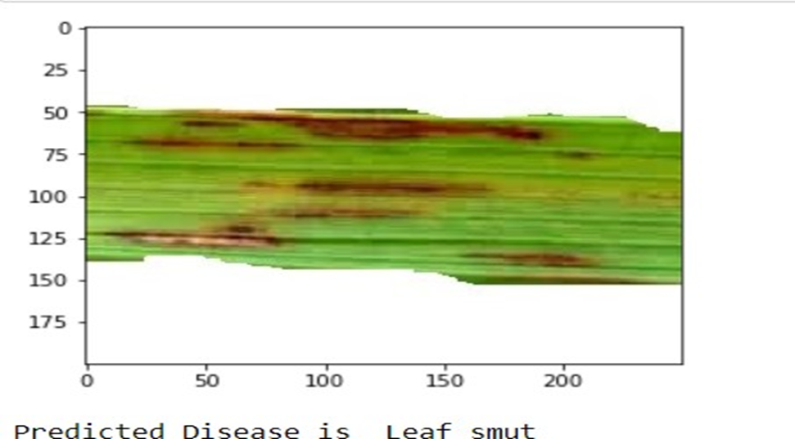

Slide 31
References
[1] K. Padmavathi, and K. Thangadurai, “Implementation of RGB and Gray scale images in plant leaves disease detection –comparative study,” Indian J. of Sci. and Tech., vol. 9, pp. 1- 6,Feb. 2016. [2] Dr.K.Thangadurai, K.Padmavathi, “Computer Vision image Enhancement For Plant Leaves Disease Detection”, 2014 World Congress on Computing and Communication Technologies.
[3] Kiran R. Gavhale, and U. Gawande, “An Overview of the Research on Plant Leaves International Journal of Pure and Applied Mathematics Special Issue 882 Disease detection using Image Processing Techniques
[4] Y. Q. Xia, Y. Li, and C. Li, “Intelligent Diagnose System of Wheat Diseases Based on Android Phone,” J. of Infor. & Compu. Sci., vol. 12, pp. 6845-6852, Dec. 2015.
[5] Wenjiang Huang, Qingsong Guan, JuhuaLuo, Jingcheng Zhang, Jinling Zhao, Dong Liang, Linsheng Huang, and Dongyan Zhang, “New Optimized Spectral Indices for Identifying and Monitoring Winter Wheat Diseases”, IEEE journal of selected topics in applied earth observation and remote sensing,Vol. 7, No. 6, June 2014

Slide 32
[5] Wenjiang Huang, Qingsong Guan, JuhuaLuo, Jingcheng Zhang, Jinling Zhao, Dong Liang, Linsheng Huang, and Dongyan Zhang, “New Optimized Spectral Indices for Identifying and Monitoring Winter Wheat Diseases”, IEEE journal of selected topics in applied earth observation and remote sensing,Vol. 7, No. 6, June 2014
[6] Monica Jhuria, Ashwani Kumar, and RushikeshBorse, “Image Processing For Smart Farming: Detection Of Disease And Fruit Grading”, Proceedings of the 2013 IEEE Second International Conference on Image Information Processing (ICIIP-2013)
[7] Zulkifli Bin Husin, Abdul Hallis Bin Abdul Aziz, Ali Yeon Bin MdShakaffRohaniBinti S Mohamed Farook, “Feasibility Study on Plant Chili Disease Detection Using Image Processing Techniques”, 2012 Third International Conference on Intelligent Systems Modelling and Simulation.
[8] Mrunalini R. Badnakhe, Prashant R. Deshmukh, “Infected Leaf Analysis and Comparison by Otsu Threshold and k-Means Clustering”, International Journal of Advanced Research in Computer Science and Software Engineering, Volume 2, Issue 3, March 2012.
[9] H. Al-Hiary , S. Bani-Ahmad, M. Reyalat, M. Braik and Z. ALRahamneh, “Fast and Accurate Detection and Classification of Plant Diseases”, International Journal of Computer Applications (0975 – 8887)Volume 17– No.1, March 2011

Slide 33
THANK YOU!

